Slide 1
Home IoT Management in ARENA
Final Presentation, M202A
Patrick Han and Suvir Mehrota
Notes:
Suvir
Just introduce us, and mention that this presentation will mainly be focused on showcasing the demos, and more design details are on the website

Slide 2
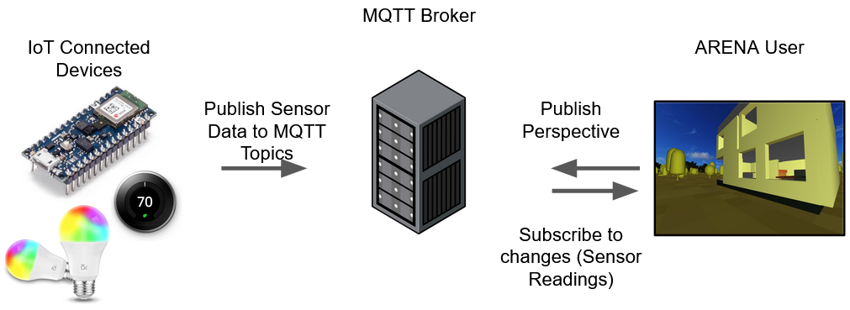
Project Introduction and Goal
Overall Project Goal: Demonstrate several interesting meaningful use cases of managing IoT devices in the 3D space (ARENA) with a physical touch
Notes:
Patrick

Slide 3
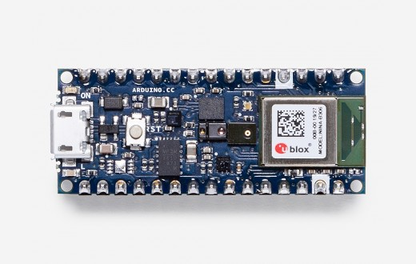
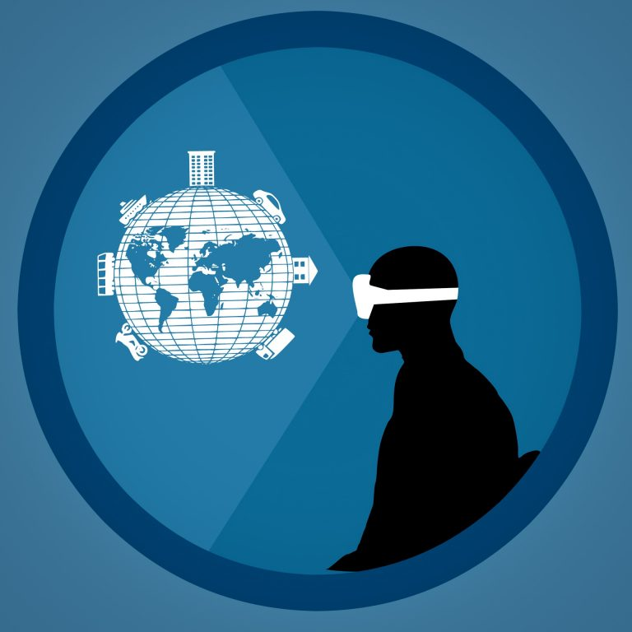

Our Design (Hardware and Tools)
Arduino 33 BLE Sense: temperature, humidity sensors, LEDs
Would have liked to use more hardware if not for COVID-19
ARENA-py library: Parsing and forwarding data to the ARENA scene
Blender 3D: Building 3D models of the apartment and scene objects
https://www.blender.org/
https://store.arduino.cc/usa/nano-33-ble-sense-with-headers
https://conix.io/arena
Notes:
Suvir
Just need to briefly talk about the tools, mentioning we would have liked to use more hardware if not for COVID-19

Slide 4
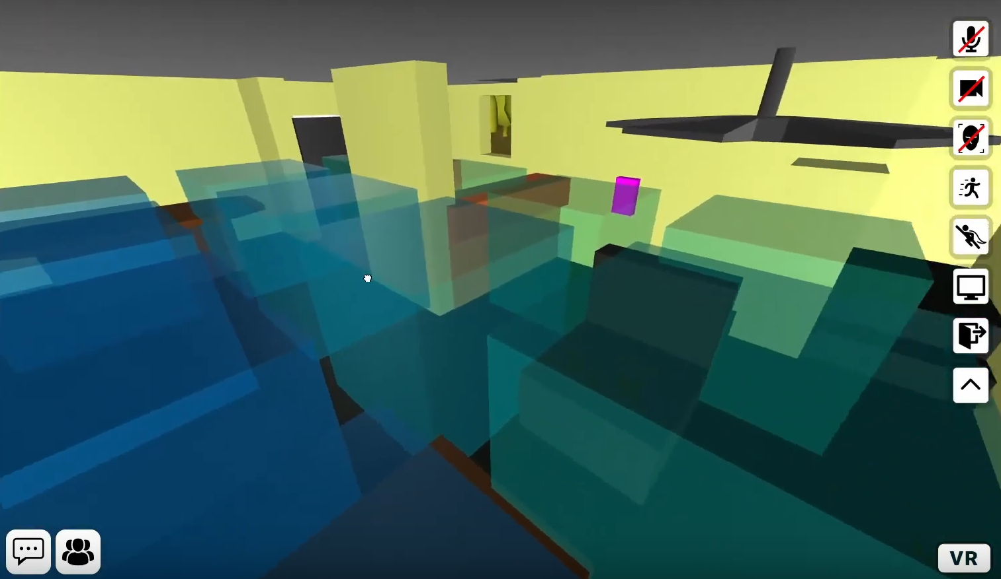
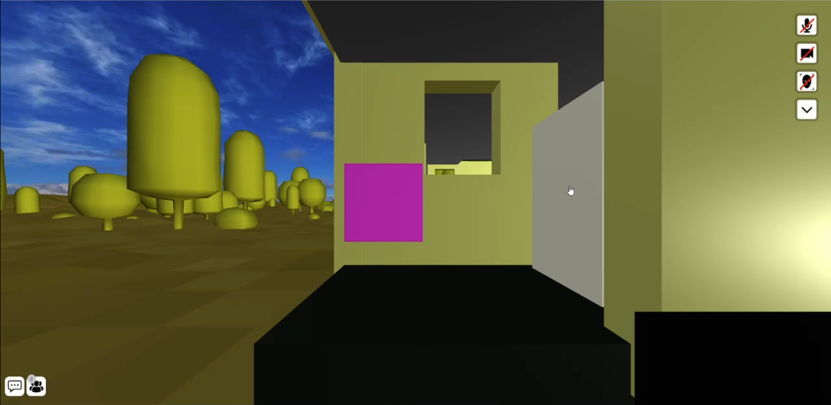
Our Design (cont.)
Put together two more demos:
Generalized Heat Maps (Made by Patrick): Map out any 3D signal in the space with multiple (simulated) sensors and act appropriately (temperature, WiFi strength, gas leak, etc.)
Smart Lock Management (Made by Suvir): You have an entrance to your building with an IoT lock. You’re away, but you may need to unlock the door for people who request it.
Notes:
Suvir
Just briefly describe what each demo does

Slide 5
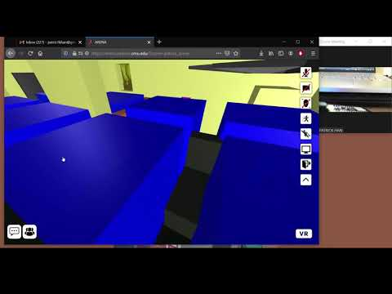
Generalized Heatmaps Demo (Patrick)
Notes:
Patrick

Slide 6
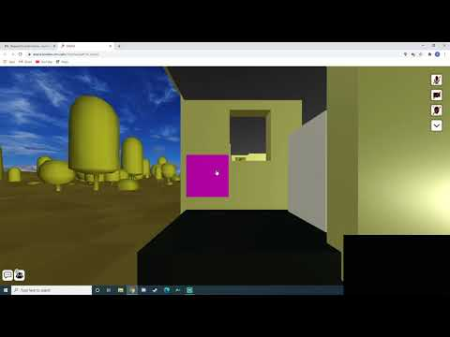
Demo Video 2 (Suvir)
Notes:
Suvir

Slide 7
Conclusion, Acknowledgements, and Further Work
ARENA is an amazing platform that provides developers an easy way to connect IoT devices to the virtual space
We presented two useful and practical demos for home IoT management
Being able to use multiple real sensors post-pandemic would be great
These demos can easily be reconfigured to read and write to more real devices
Faced some difficulties: Still in heavy development, Nuno Pereira & Michael Farb @ CMU were a big help in getting issues resolved!
Thank you to Dr. Srivastava (Course instructor)
More design and implementation details on project website!: https://suvir-patrick.github.io/
Notes:
Patrick
Just talk about each bullet point here, (don’t need to mention the last one about the website)

